Slide 1
Conjoint Analysis using R

Slide 2
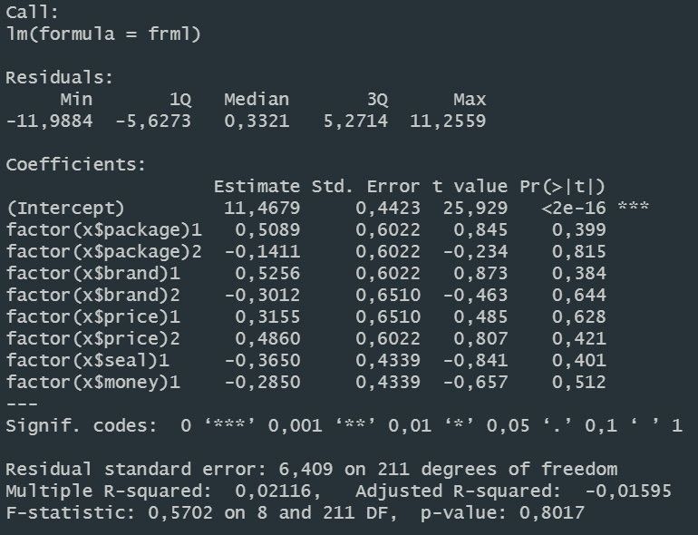
Conjoint Analysis

Slide 3
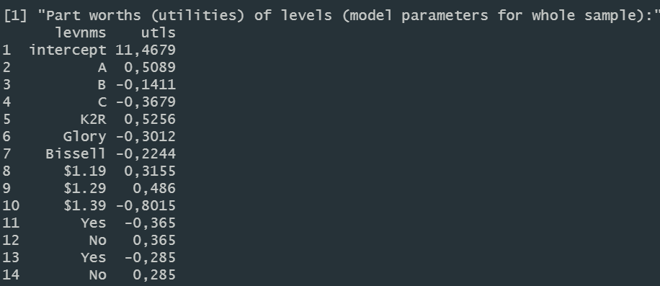

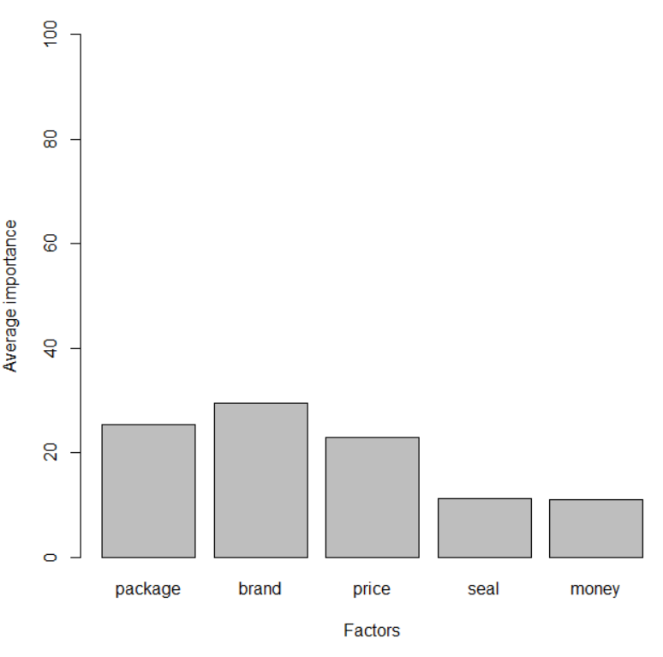
Part Worth Utilities
In terms of factor importance, Brand is most important followed by Package and Price. Seal and Money are not important

Slide 4
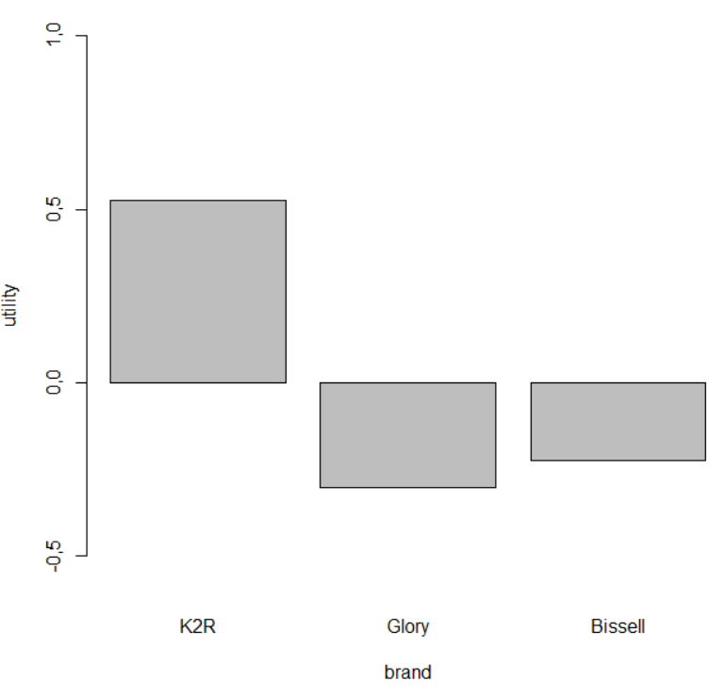
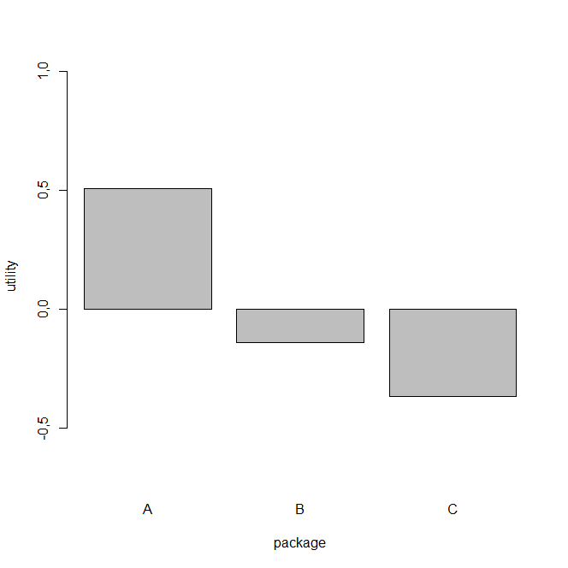
Part Worth Utilities
Although Brand is most important factor when considering carpet cleaner, customer prefer K2R above other brands
Packaging A is strongly preferred to packaging C and somewhat to packaging B

Slide 5
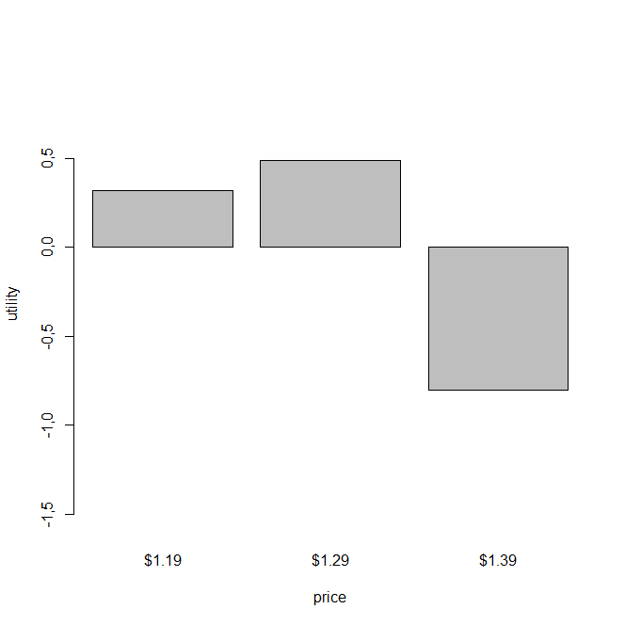
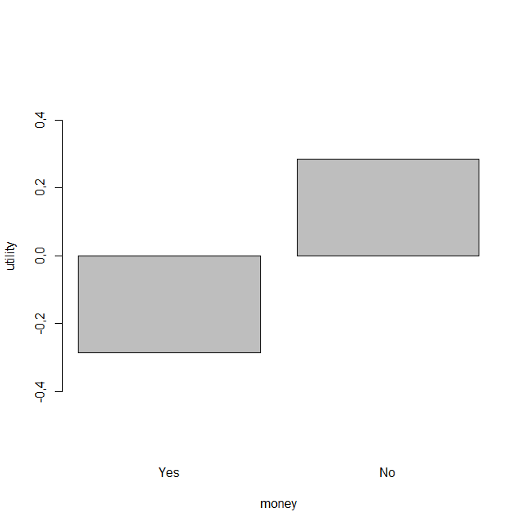
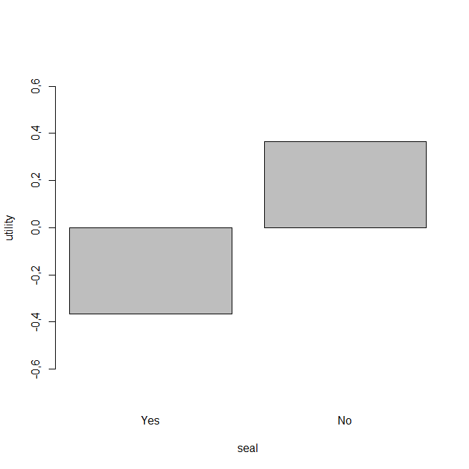
Part Worth Utilities
No Seal is preferred to Yes
Price point 1.29 is highly preferred relative to 1.39 and somewhat to 1.19
Similarly, No Money back guarantee is preferred to Money back guarantee

